Slide 1

PDT – The PHP Development Toolkit
Assaf Almaz,
PDT project leader at Zend Technologies

Slide 2
Overview
Introduction
PHP
PDT Project Goals
PDT 1.0
  Features (demo)
  Infrastructure
PDT 1.1
  Improved Infrastructure
  New Features introduction
Q&A

Slide 3






Introduction
Zend Technologies
  The PHP Company
  Founded in 2000 by Zeev Suraski & Andi Gutman
  Headquarters in Cupertino, CA
  R&D in Israel
  Developing tools and web application servers for PHP community
Zend Core
Certified PHP
Zend Platform
HA-Cluster
Zend Studio
IDE
Zend Guard
Security
Zend Framework

Slide 4

PHP
Open source
Server Side Scripting Language
Designed to create Dynamic Web Applications
Designed for extensibility

Slide 5
PHP
History
  1994 – created by Rasmus Lerdorf
  1997 – parser rewritten by Zeev Surski and Andi Gutman
  1998 – PHP v3.0
  2000 – PHP v4.0
  2004 – PHP v5.0
    Object Oriented programming
    Integrated SOAP
    Exceptions handling
Most Recent version: PHP 5.2.5 (Nov 2007)

Slide 6
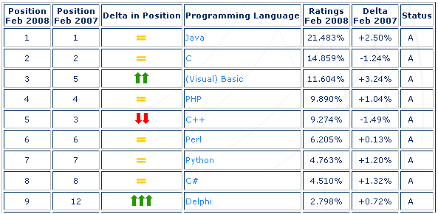
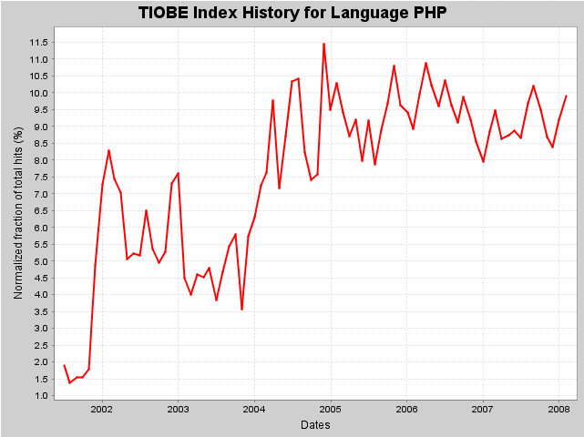
PHP Landscape
Over 2,500,000 developers
Over 20,000,000 web sites
Mature language with many extensions
Enterprise Applications

Slide 7

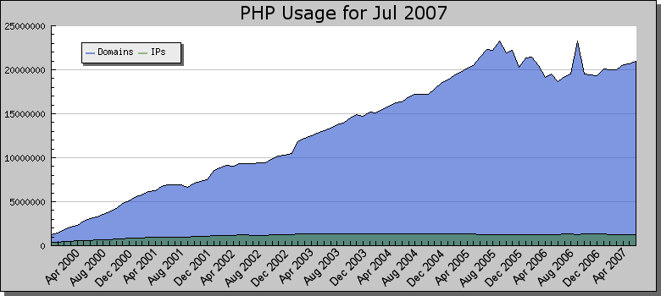



PHP Landscape
Over 2,500,000 developers
Over 20,000,000 web sites
Mature language with many extensions
Enterprise Applications
Yahoo

Slide 8






PHP Landscape
Over 2,500,000 developers
Over 20,000,000 web sites
Mature language with many extensions
Enterprise Applications

Slide 9







PHP Landscape
Over 2,500,000 developers
Over 20,000,000 web sites
Mature language with many extensions
Enterprise Applications

Slide 10
PDT – Project Goal
Deliver an extensible PHP development tool
and framework for the Eclipse platform
  Enlarge the Eclipse community with PHP developers
  Answer PHP development needs.
  Provide a framework for development tools of PHP

Slide 11
PDT 1.0
Roadmap
  March 2006: Project Creation review
  August 2006: Requirements & Specification review
  April 2007: PDT 0.7 released
  Sept 2007: PDT 1.0 released
  January 2008: PDT 1.0.2 released
  May 2008: PDT 1.0.3 scheduled

Slide 12
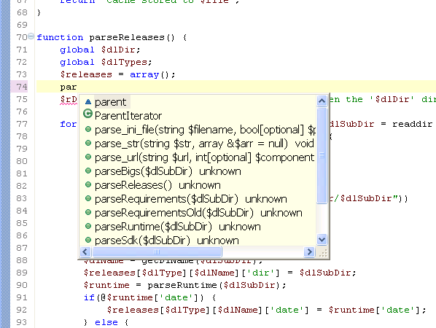
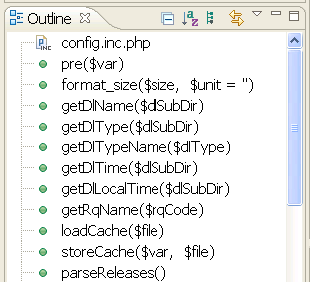
PDT 1.0 - Features
Syntax Coloring
Editor
  Code Assist
  Syntax coloring
  Code folding
  Code formatting
  Go to declaration (ctrl + click)
  Annotations (task, breakpoints, CVS)
Views
  Project view
  Outline view
  Problems view integration
  Open PHP element
Code Assist
Outline View

Slide 13
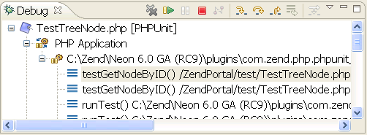
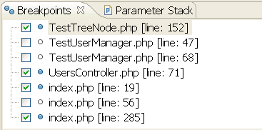
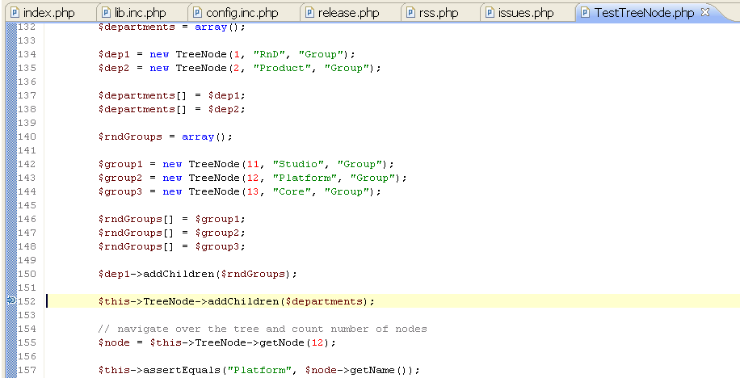
PDT 1.0 - Features
PHP Debugging
  Local debugging (PHP script)
  Remote debugging (PHP Web Pages)
Eclipse features
  CVS (Team support)
  Search (PHP)
  Tasks

Slide 14
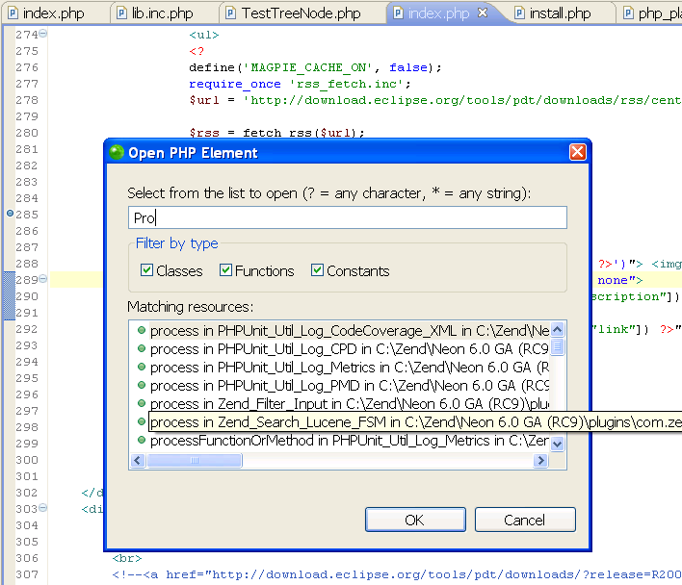
PDT 1.0 - Infrastructure
PHP Model
  Contains
    Declarations: Classes, Methods, Functions, Constants, Class Fields, variables.
    Code Data Resolver – guess the type inference
  Used for
    Code assist
    Open declaration (ctrl + click)
    Open PHP Element
    Outline View (File data)
  Model types
    PHP Language model (PHP v4, PHP v5)
    PHP User model (Defined by user)
    Included Libraries & Dependant projects

Slide 15
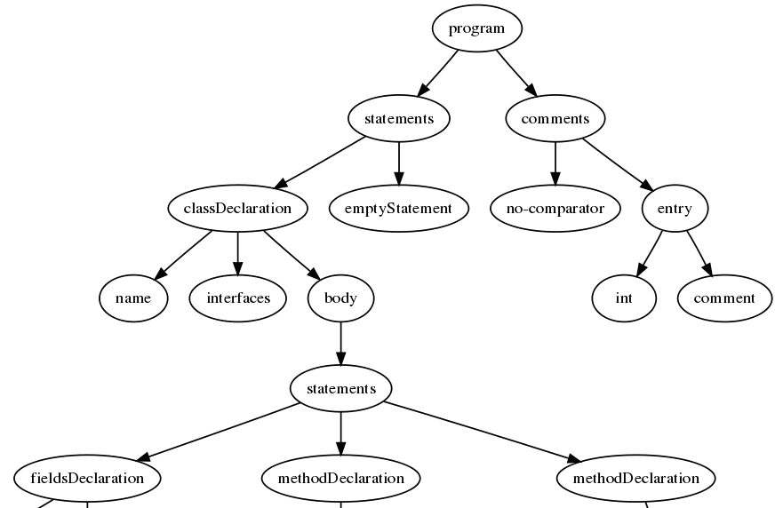
PDT 1.0 - Infrastructure
PHP Structured Document
  Provides different processing for HTML, JavaScript, CSS and PHP
  such as Syntax coloring, code assist etc…
AST – Abstract Syntax Tree
  Tree representation of the source file
  Can be used for:
    Advanced Code formatting
    Static analysis of code
Debugger Protocol
  Can be extended to:
    Add Debugger implementations
    PHP Unit

Slide 16
PHP = Dynamic Language => Challenges
Dynamic Language definition
Execute at Runtime many common behaviors
that other languages perform during compilation
Challenges
  No Type safety
  Dynamic definition of fields and methods at runtime
  Dynamic inclusion of files at runtime

Slide 17
PHP = Dynamic Language => Challenges
No type safety
$a = new MyClass();
$a-> // code assist for MyClass
if( $results > 5 )
{
$a = new ClassB();
$a-> // code assist for ClassB
}
$a-> // Ambiguity

Slide 18
PHP = Dynamic Language => Challenges
Dynamic definition of fields and methods
class Person
{
private $m_firstName;
...
}
$a = new Person(“Assaf”);
$a->m_lastName = “Almaz” // dynamically define new public field
foo($a);
function foo($a_person)
{
$a_person-> // should m_lastName be in code assist?
}

Slide 19
PHP = Dynamic Language => Challenges
Include file that defines a variable
$a = new MyClass();
$a-> // code assist for MyClass
include “someFile.php”;
$a-> // code assist for ClassB
include $_REQUEST[“urlParam”];
…
$a = new ClassB();
…

Slide 20
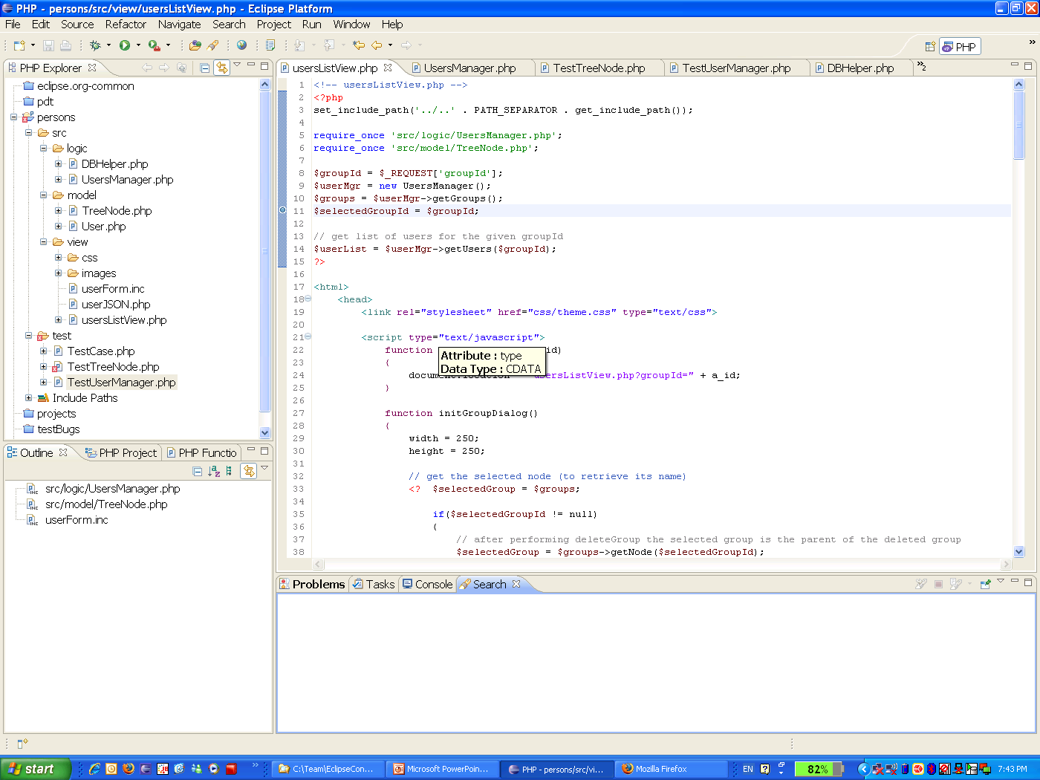
Demo

Slide 21
PDT 1.1
Improve the PDT Infrastructure and introduce
few features as test cases for the infra
Roadmap
  Dec 2007: Content Definition
  May 2008: Milestone 1
  June 2008: Milestone 2
  August 2008: Release Cycle
  Sept 2008: PDT 1.1 released

Slide 22
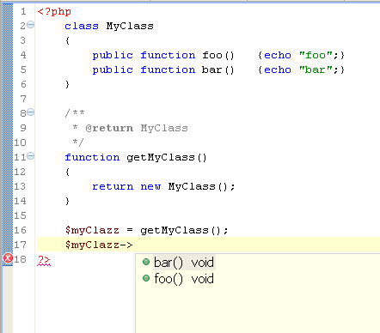
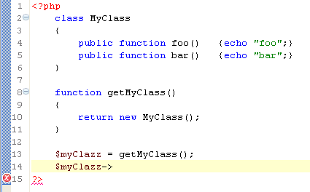
PDT 1.1 - Infrastructure
Upgrade to Eclipse 3.4 (Web Tools 3.0)
Enhance the PHP Model
  References: class instances, method calls, function calls.
  Indexing: reduce memory consumption of the current model
  Type inference – base on code analysis
PDT 1.0
PDT 1.1
Requires @return
Requires @return

Slide 23
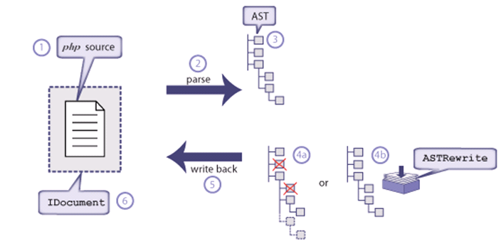
PDT 1.1 - Infrastructure
AST – Rewrite
  Bi-directional connectivity between AST and Editor
    Manipulating the AST reflects on PHP source code and vise versa
  Used for:
    Code Generation (getter/setter, override/implement)
    Code manipulation (Refactoring)

Slide 24
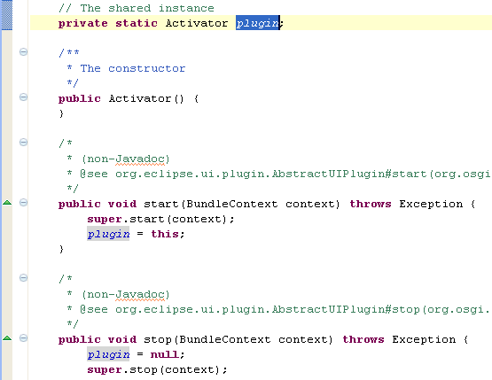
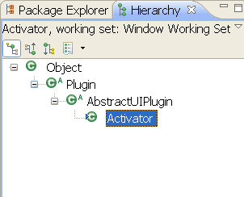
PDT 1.1 – New Features
Editor
  Mark occurrences
  Override annotation
  Getter/Setter
  Override/Implement
PHP 5.3 support
Views
  Type hierarchy
Debugger
  Filtering
Mark Occurrences
Override Annotation
Type Hierarchy

Slide 25

Additional Sessions & Resources
APDT – Aspect PHP Development Toolkit
  13:30 Room 209/210 William Candillon
Extending the PDT project
  14:00 Room 209/210 Roy Ganor (Zend Technologies)
PDT Web Site
  www.eclipse.org/pdt
PDT download
  http://download.eclipse.org/tools/pdt/downloads
PDT including local debugger:
  http://www.zend.com/en/community/pdt
Download PHP Stack (including Apache & MySQL)
  http://www.zend.com/en/products/core/downloads
PDT
All in one IDE
Zend Core
Certified PHP

Slide 26
Thank You !

